Slide 1
VIT BHOPAL
Web Design
TEAM MEMBERS
B. Santosh Kumar 18BCE10081
P. Nile Krupa Sheel 18BCE10183 P.C.V.V. Mounish 18BCE10187
T. Mahesh 18BCE10280
PROJECT GUIDE :
Mr. ASHISH KUMAR SAHU

Slide 2

OBJECTIVE :
IN TODAY’S FAST AND COMPETETIVE WORLD, A UNIVERSITY FIRST’S FACE IS IT’S WEBSITE. IF ANY PERSON WANT TO KNOW ABOUT A UNIVERSITY THE WOULD BE FIRST LOOKING INTO ITS WEBSITE .
WANT TO MAKE OUR UNIVERSITY WEBSITE BETTER AND ADD SOME NEW FEATURES TO IT. SO THAT IT’S USER INTERFACE WOULD BE BETTER .

Slide 3

PROBLEM STATEMENT :
MAKING THE MODULE 2 -
THE LIVE CHAT CODE WAS NOT RESPONDING TO INTERNET RECEIVING DEVICE, SO WE HAD TO TRY WITH AN ALTERNATIVE
PROBLEM SOLVING
THE PROBLEM WAS RECTIFIED BY USING THIRD PARTY SOFTWARE INTEGRATION TO THE WEBSITE.

Slide 4
VIT BHOPAL
Module 1
Homepage
MODULE 3
SOCIAL MEDIA
Module 7
About us
Module 2
Live Chat
Module 6
In Campus
Module 5
Admissions
Module 4
Academics
Facebook VIT Bhopal
YouTube VIT Bhopal
Twitter VIT Bhopal
Instagram VIT Bhopal

Slide 5
MODULE 1 :
The homepage is the first view of the website. It firstly views us the logo of VIT Bhopal along with certain images. It also gives the contact information of the college along with it’s social media info.
MODULE 2 :
Live Chat System helps the student to get more information about VIT and to interact with the college agent and clear his doubts as and when he wishes.

Slide 6
MODULE 3 :
VIT Bhopal Facebook
VIT Bhopal YouTube
VIT Bhopal Twitter
VIT Bhopal Instagram

Slide 7
MODULE 4 : ACADEMICS :
School – In this school section, we get to know all the Schools offered in the college and their details.
FFCS – Features about the Fully Flexible Credit System in VIT Bhopal is explained in this option.
CALTech – Characteristics about the Collaborative Active Learning through Technology.
Faculty – All the qualifications of the faculty working in VIT Bhopal is noted in this part of the website.

Slide 8
MODULE 5: ADMISSIONS :
Courses offered – We get to know the list of all the courses offered in the college.
ITP – Details regarding the International Transfer Program is explained here.

Slide 9
MODULE 6: IN CAMPUS :
Events – Photos regarding all the events conducted in VIT Bhopal are sorted out here.
Library – Photos of the library in the academic block.
Student Housing – All the details regarding the hostel facility and other housing facilities provided to the student are shown here.
Sports – All the sports news that are being conducted in VIT Bhopal is seen here.

Slide 10
MODULE 7 : ABOUT US :
About VIT Bhopal – Complete Information about VIT Bhopal.
Our Vision – Vision of VIT Bhopal.
Our Mission – Mission of VIT Bhopal.
Infrastructure – Photos of infrastructure part of the college.
Location – Exact Location of the college along with the Google Maps Direction.

Slide 11
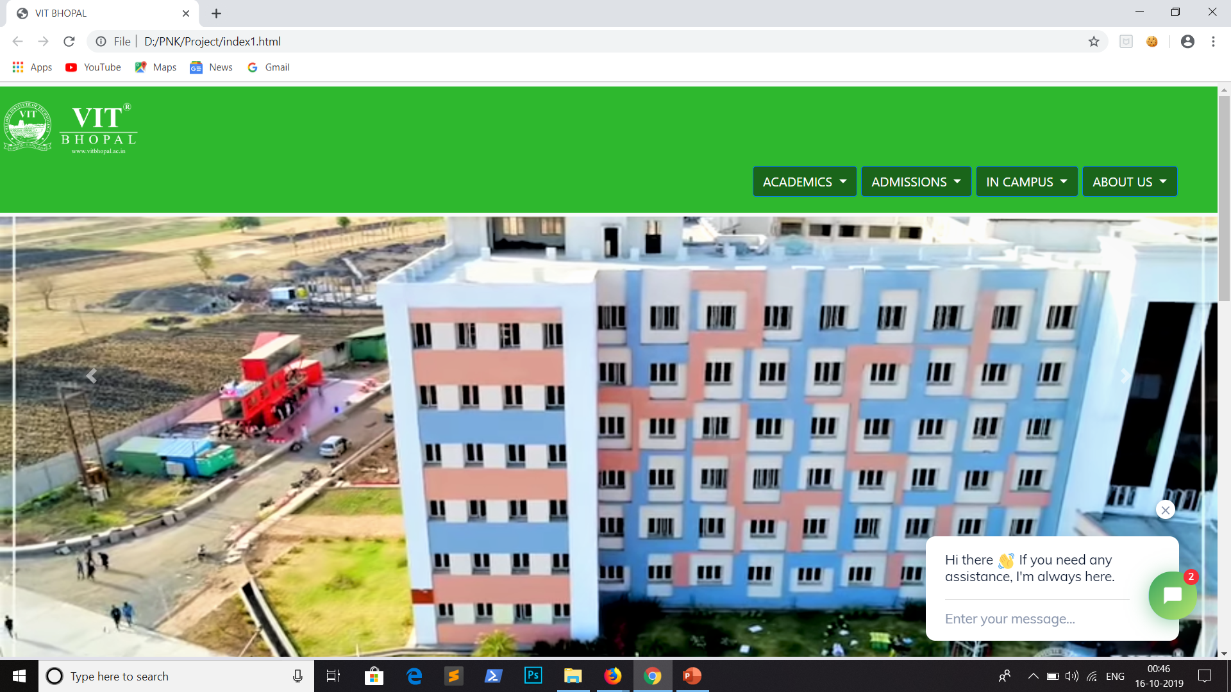
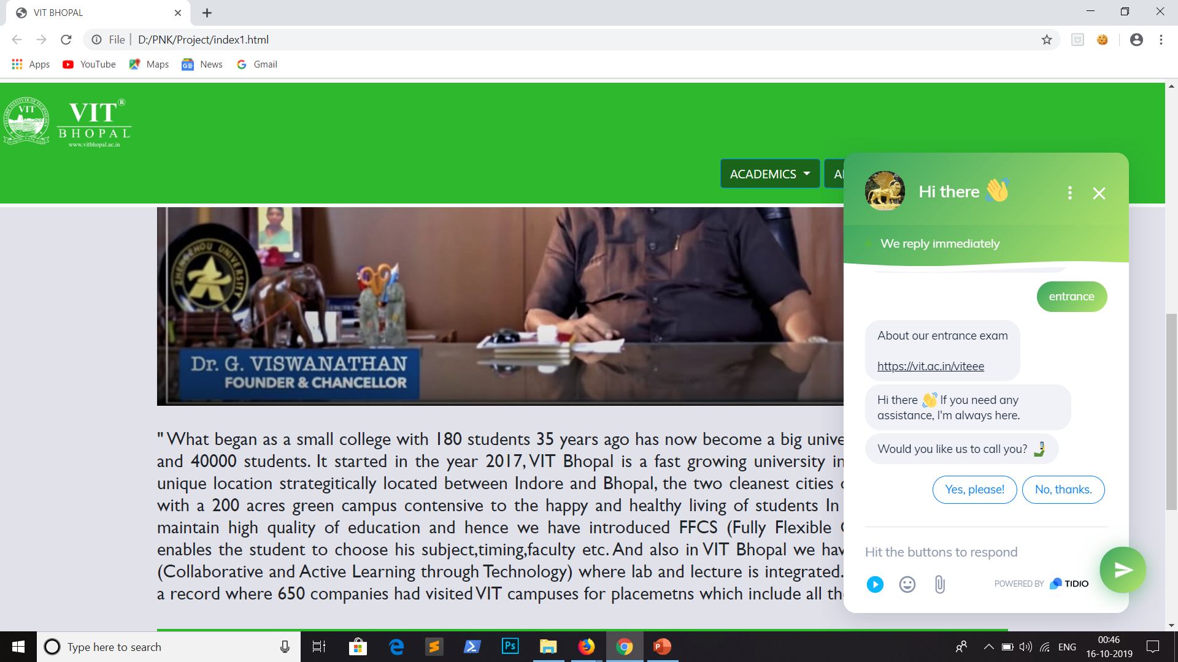

Slide 12
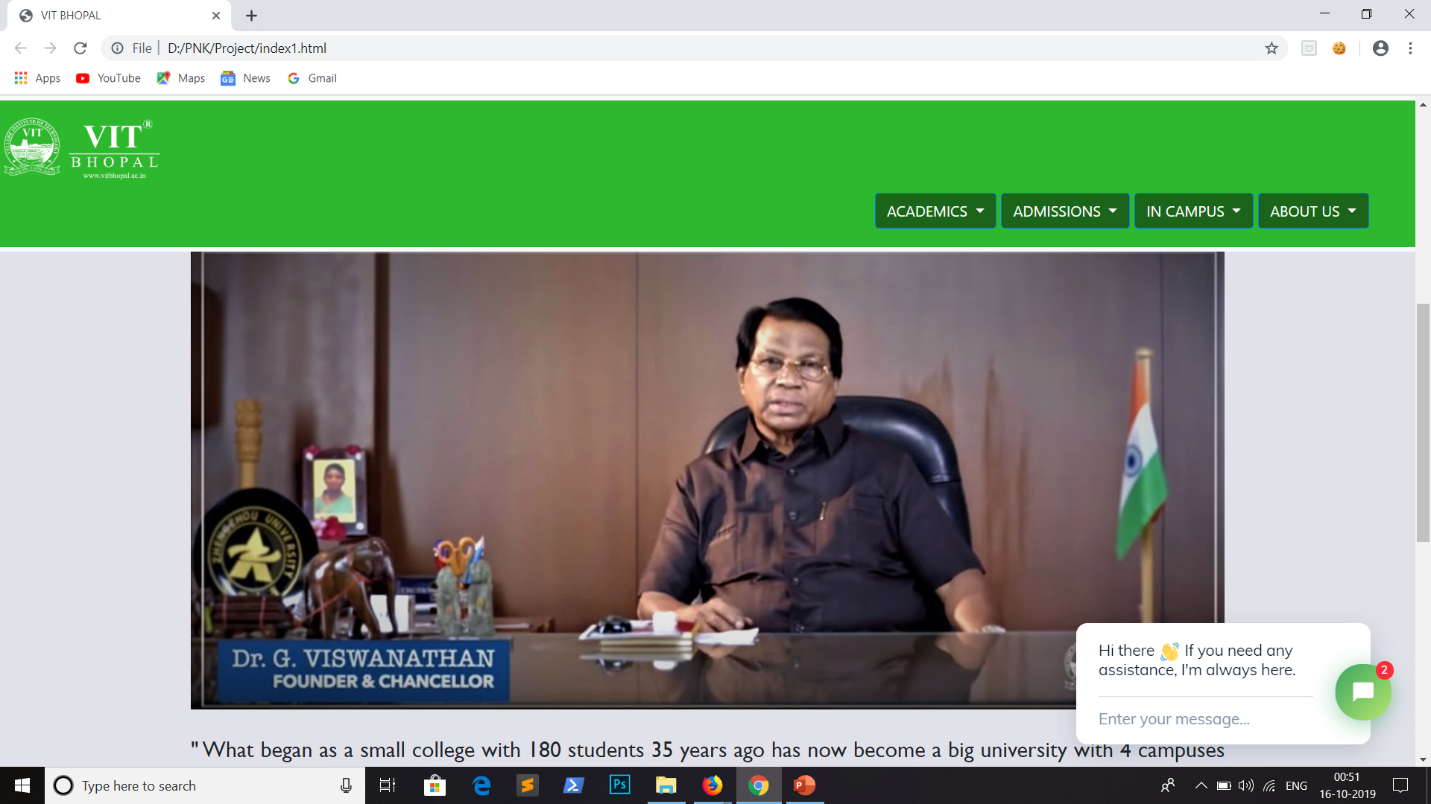
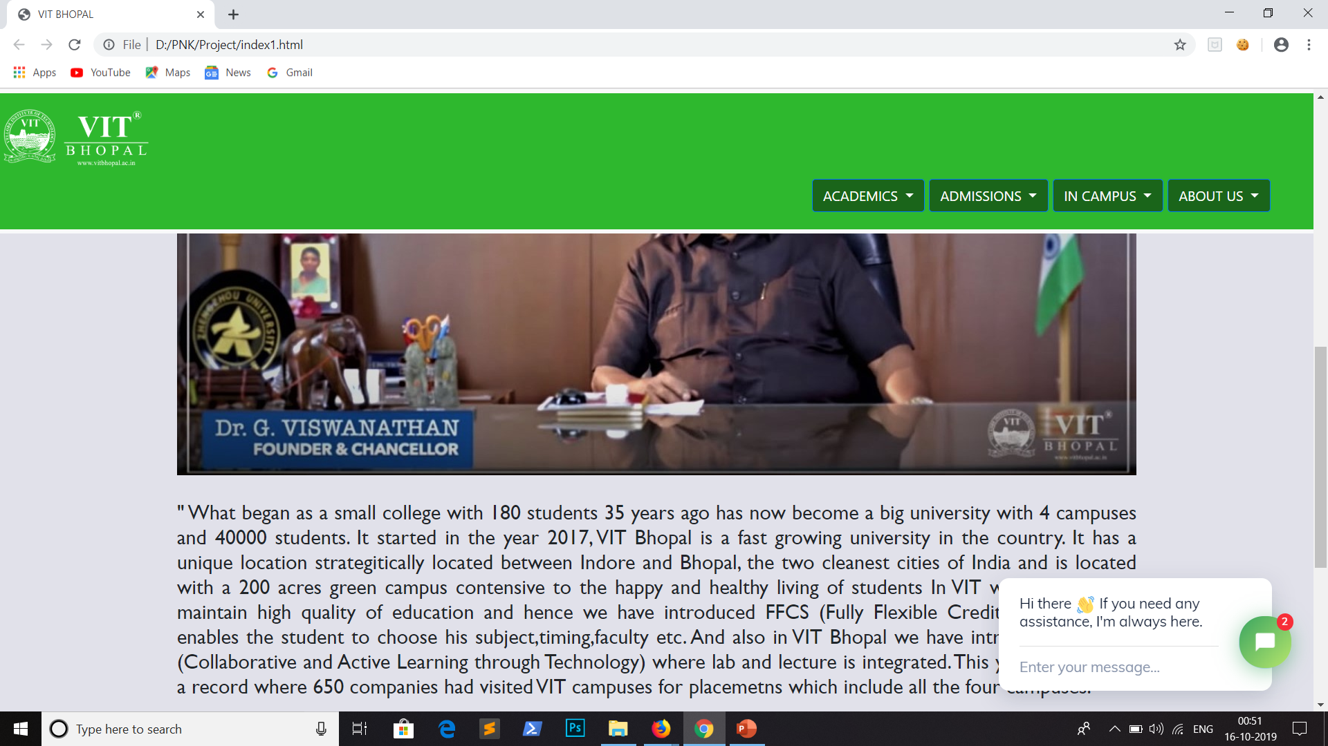

Slide 13
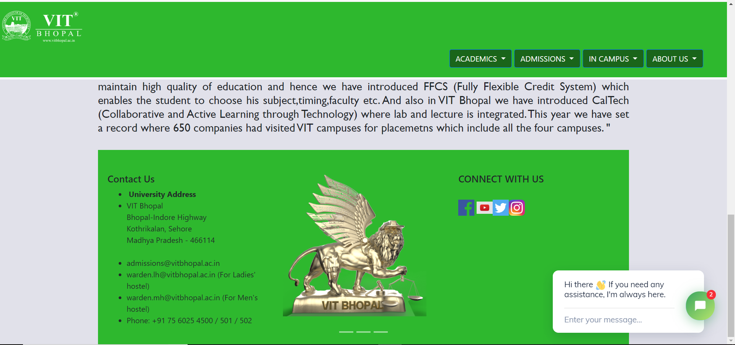

Slide 14
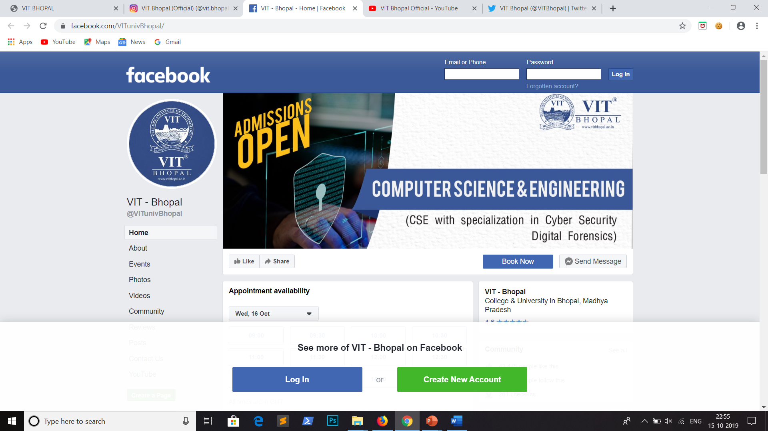
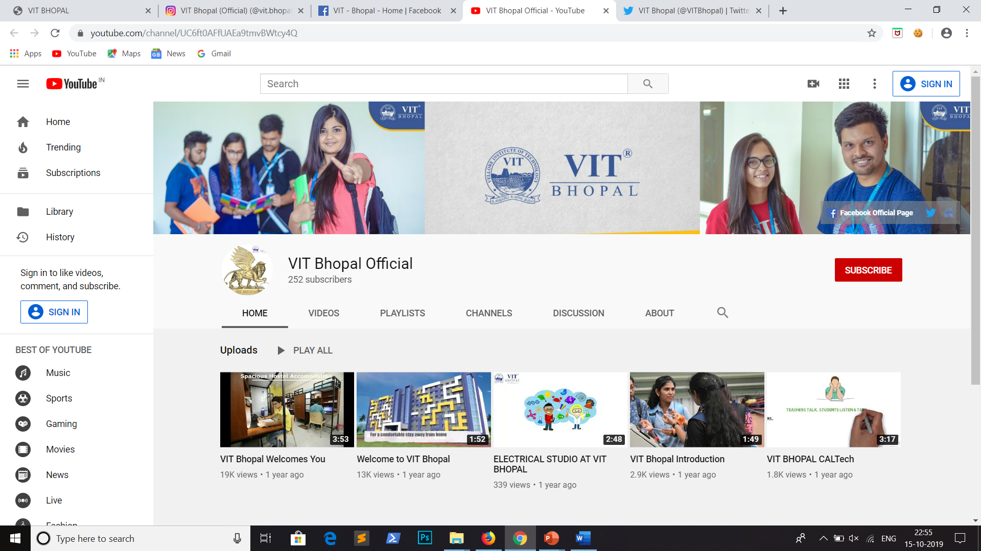
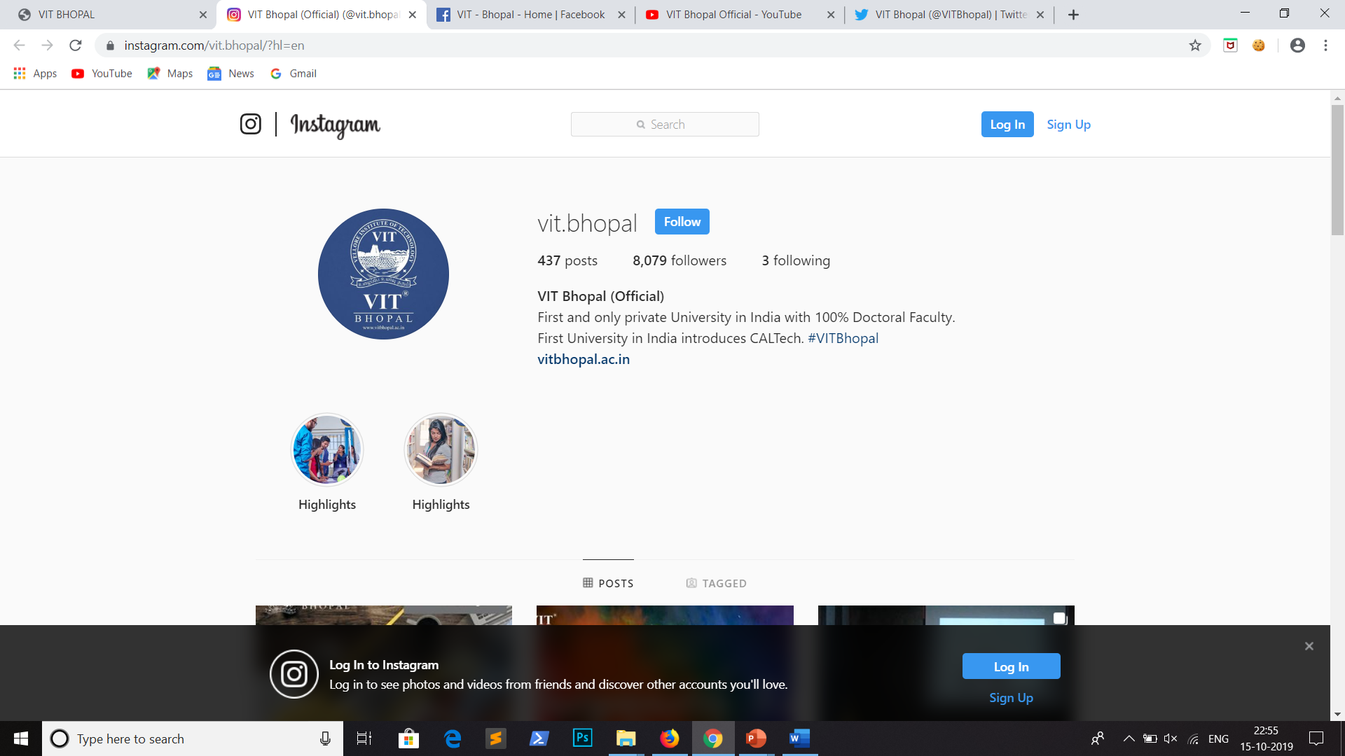
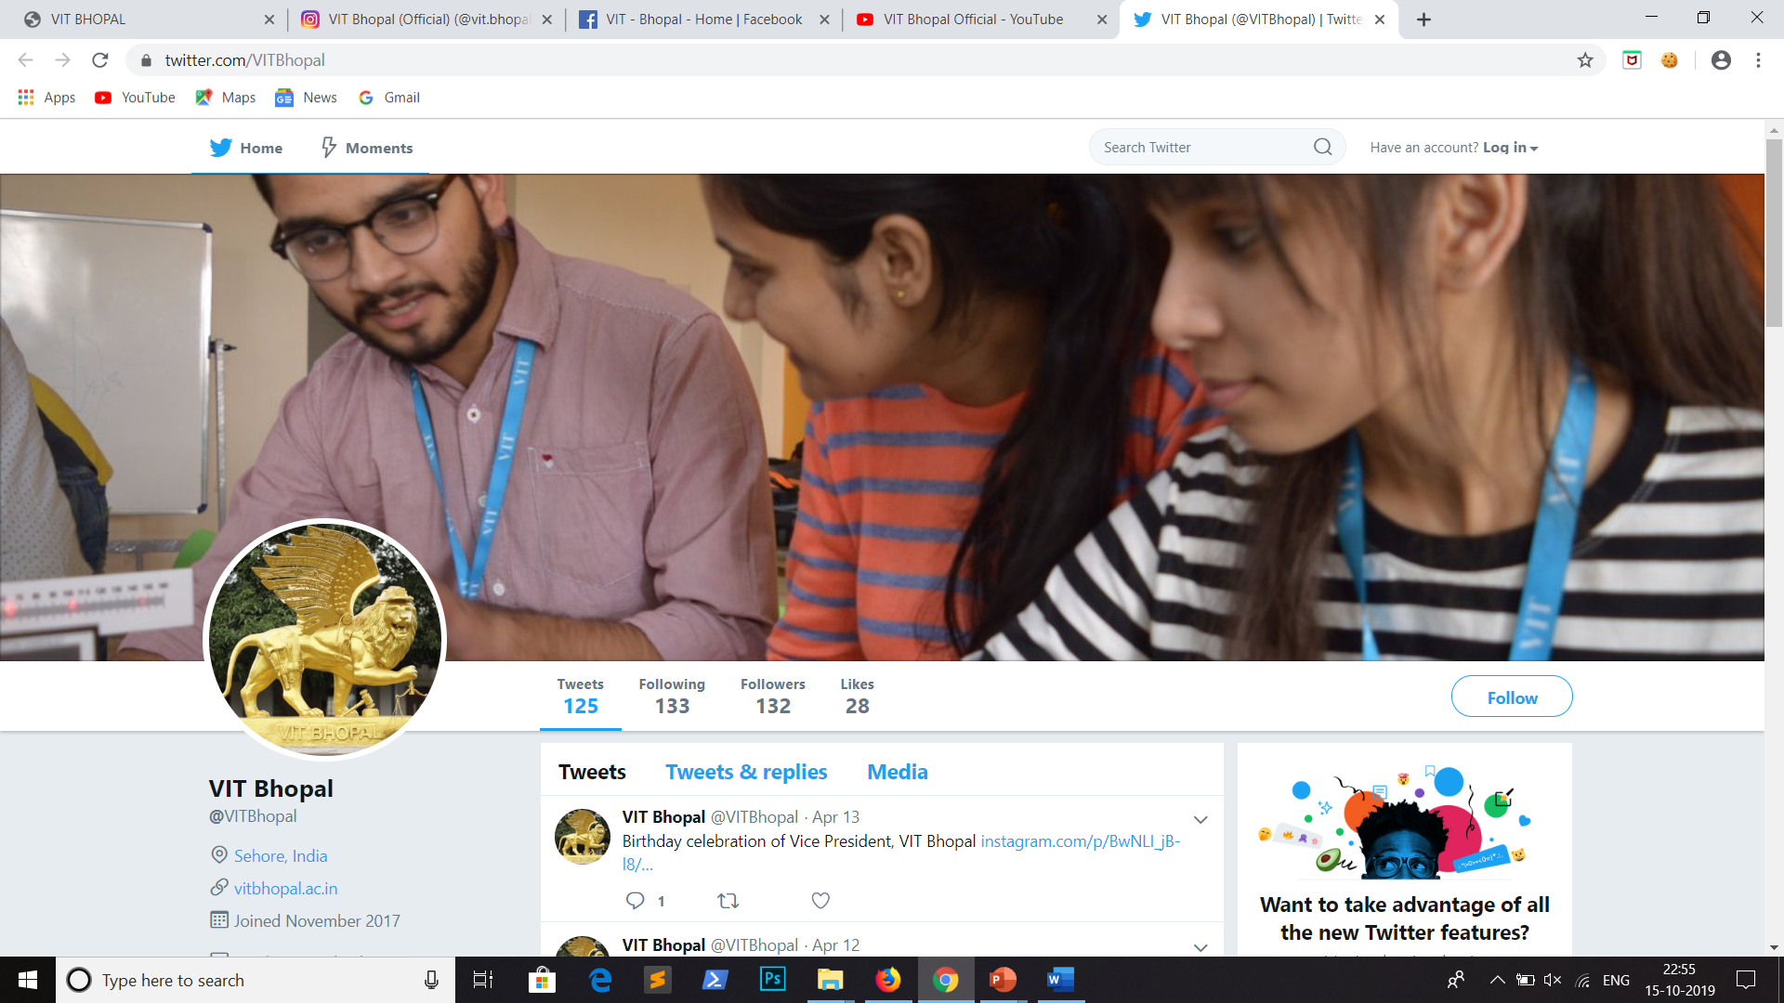

Slide 15
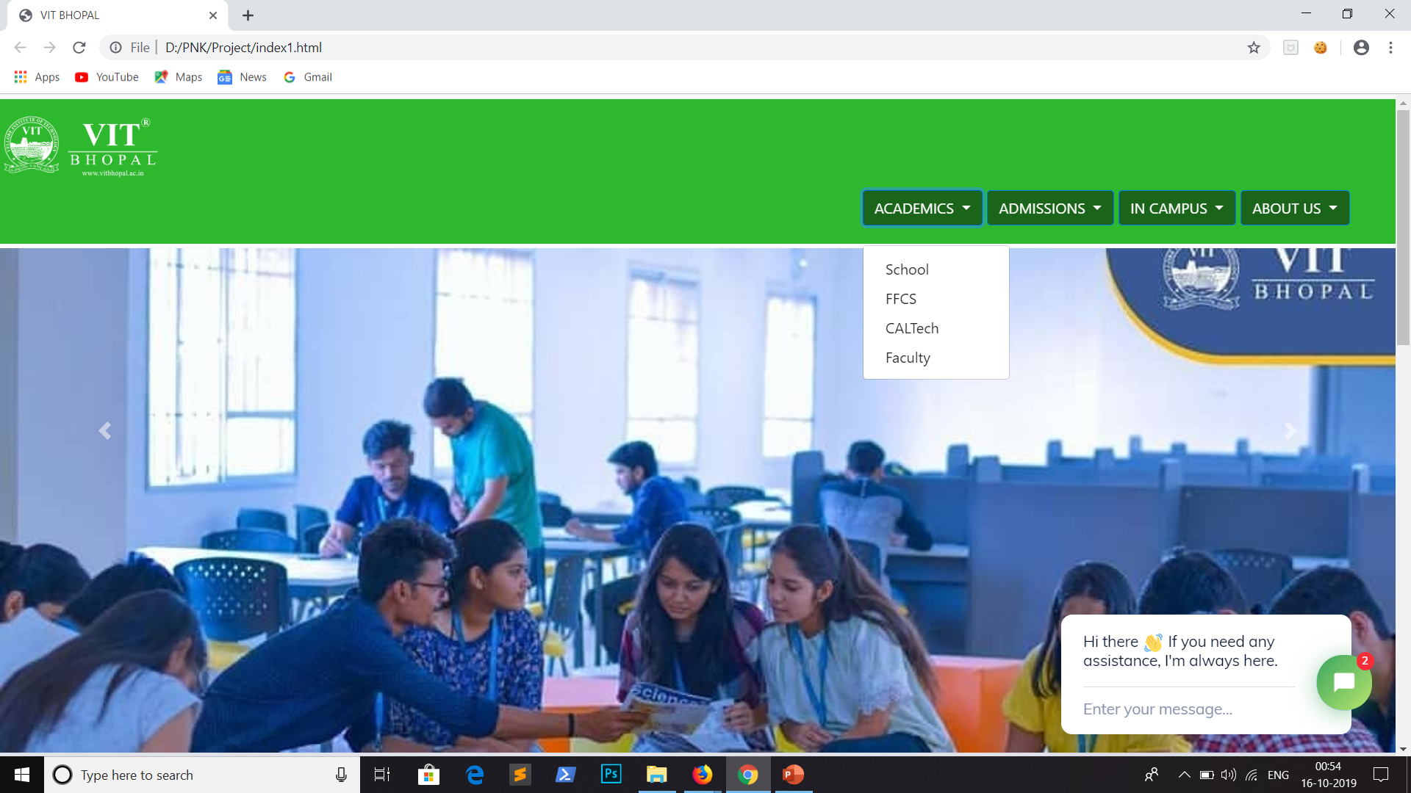
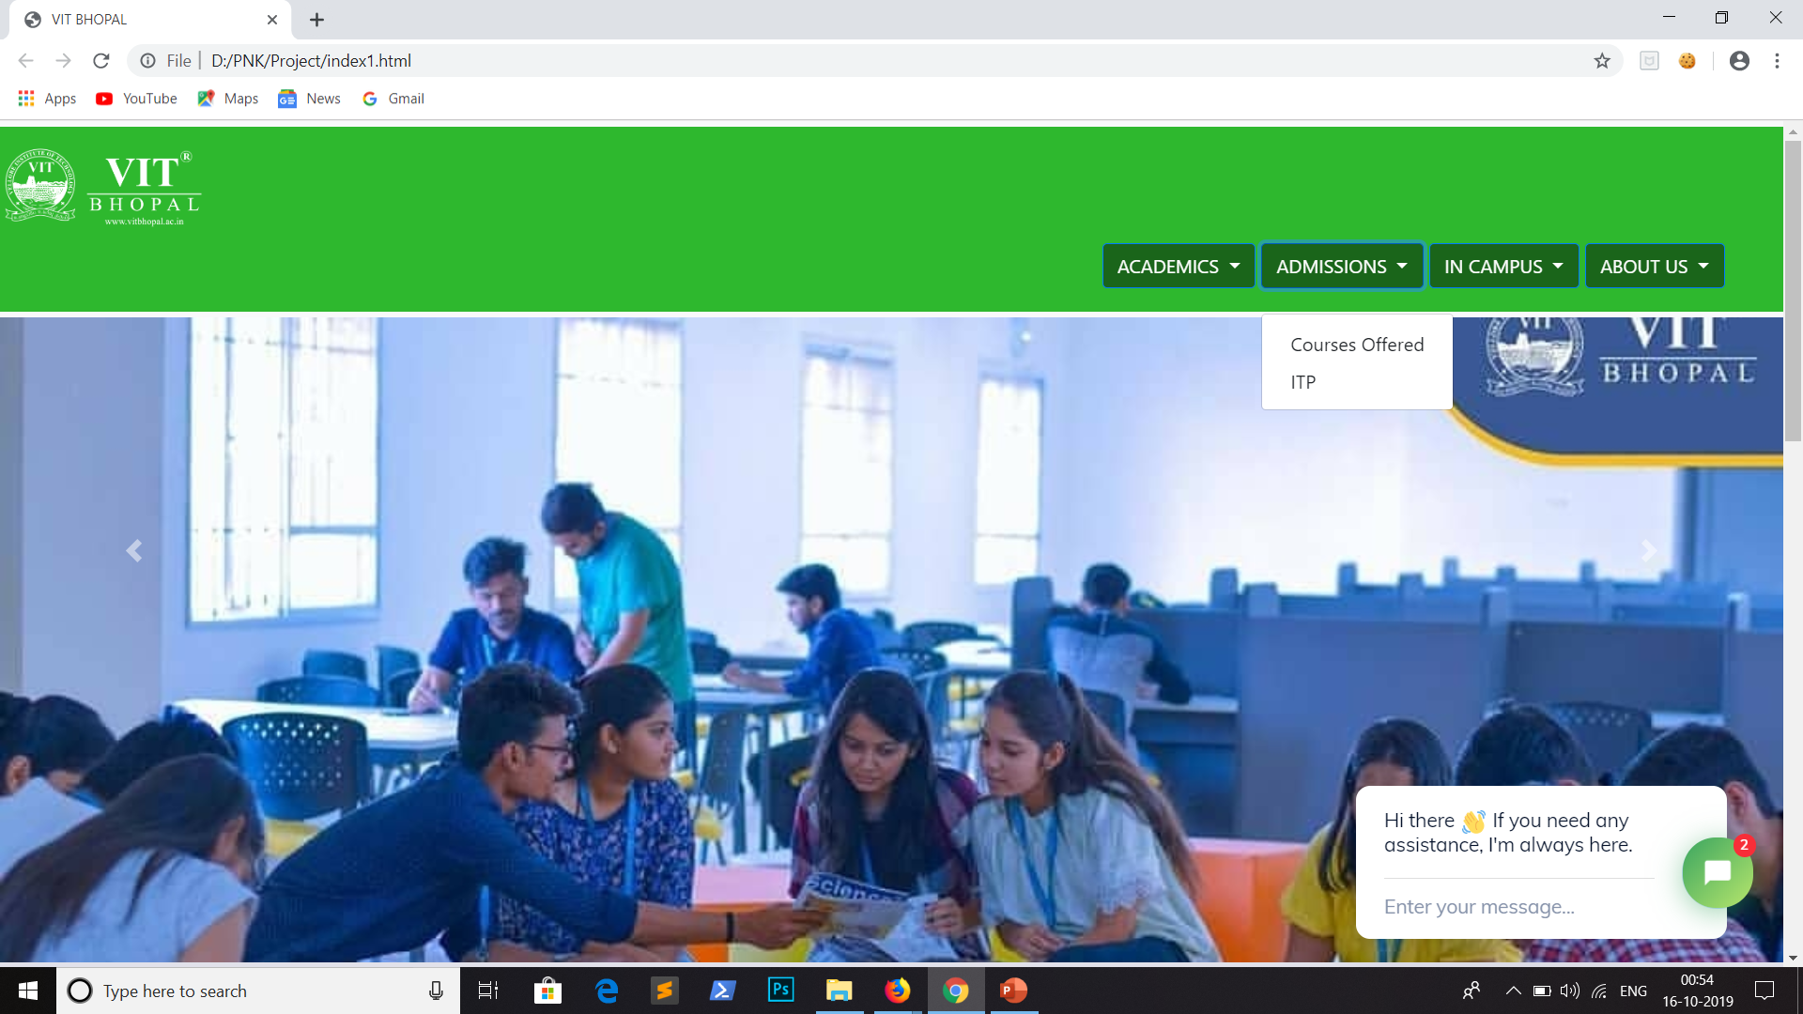
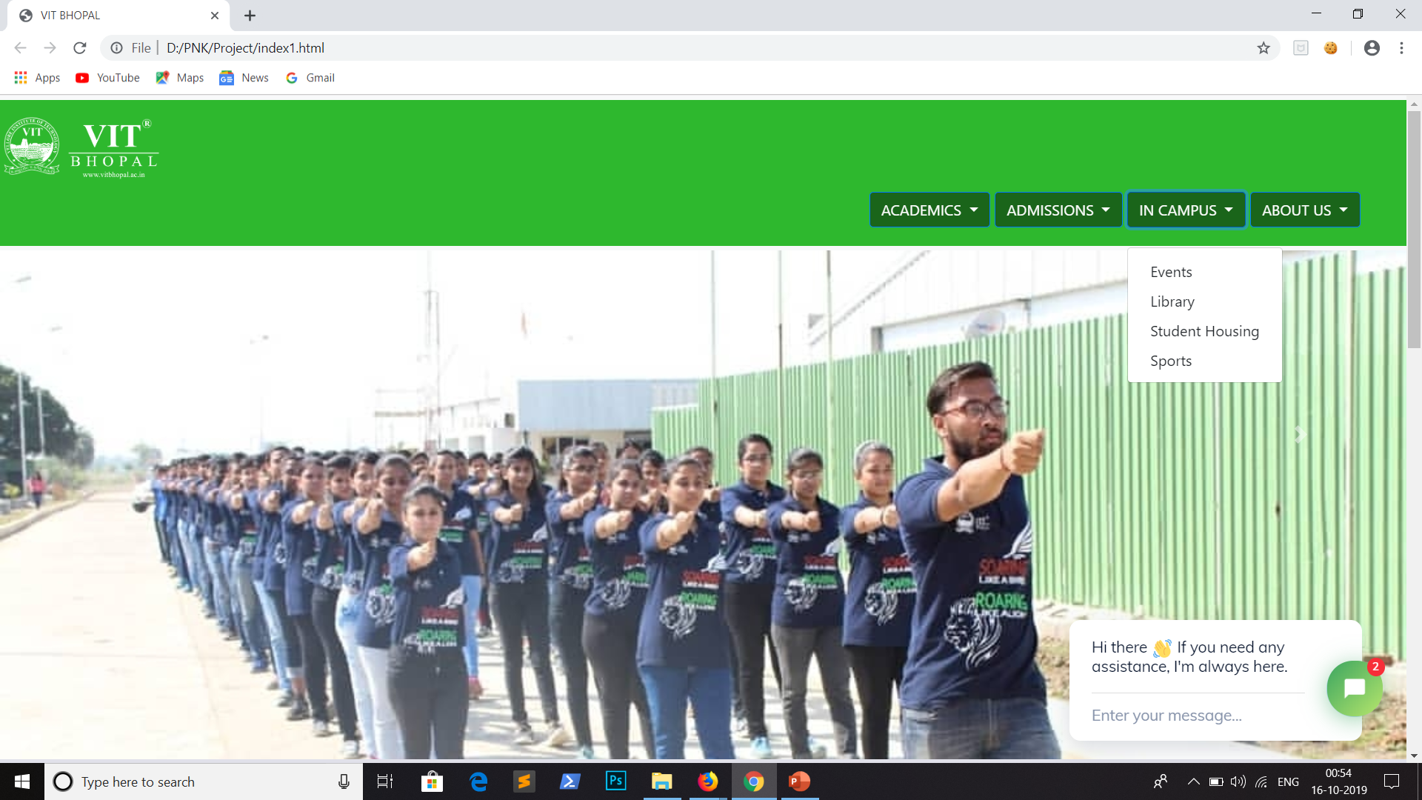
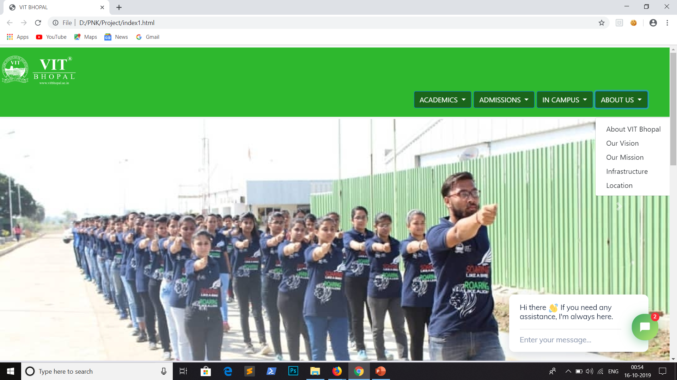

Slide 16
REFERENCES : VIT BHOPAL WEBSITE GITAM UNIVERSITY WEBSITE MIT WEBSITE HARVARD UNIVERSITY WEBSITE

Slide 17
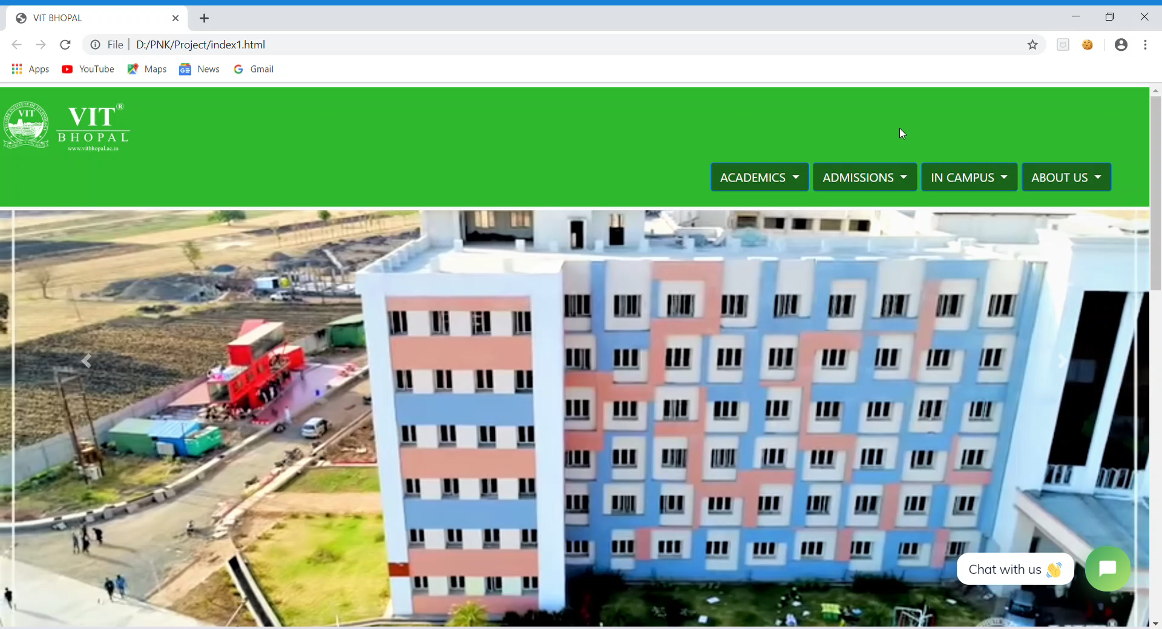

Slide 18


